Slide 1
Deferred rendering, part 1

Slide 2
FBO
Color buffer (2D Array)
RGBA8
(8 bits/pixel = 32 bits)
Can have up to 8 of these COLOR buffers
OpenGL
Depth buffer (2D Array)
(common depth = 24 bits)
(stencil = 8 bit)

Slide 3
FBO
Color buffer (2D Array
OpenGL
Color buffer (2D Array
Color buffer (2D Array
Depth buffer (2D Array)
(common depth = 24 bits)
(stencil = 8 bit)

Slide 4
FBO
Color buffer (2D Array)
RGBA8
(8 bits/pixel = 32 bi
Can have up to 8 of these COLOR buffer
OpenGL
Depth buffer (2D Array)
(common depth = 24 bits)
(stencil = 8 bit)

Slide 5

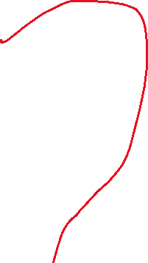
FBO
Color buffer (2D Array)
Depth buffer (2D Array)
Color buffer (2D Array)
RGBA8
(8 bits/pixel = 32 bits)
Render an object with the FBO as the texture
OpenGL
Depth buffer (2D Array)
(common depth = 24 bits)
(stencil = 8 bit)

